Slide 1
What is Open Science?
Horizon 2020 Research and Innovation Programme
Grant Agreement # 857647

Slide 2
Learning outcomes
Define the concepts of Open Science and Open Access.
Explain the benefits of Open Science practices from a researcher’s and society’s perspective.

Slide 3
Snapshot
Introduction
What is Open Science?
Benefits of Open Science
Open Access
Join now!
References

Slide 4
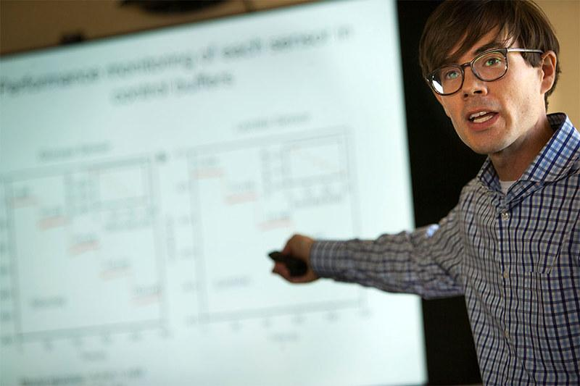
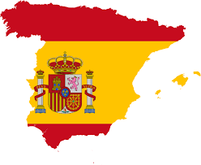
Introduction
I’m Anna, and I’m developing a new software to detect and treat human viruses at a university in Poland
I’m Pedro. I’m investigating the effects of artificial intelligence on human beings at a research institute in Spain

Slide 5
Introduction

Slide 6
What is Open Science?
Open Science is a movement to make scientific processes more transparent and results more accessible.
It’s about ‘openly creating, sharing and assessing research, wherever this is viable’, and it can be done prior, during and after research.
Increasingly, open sharing of publicly-funded research is becoming a common practice.

Slide 7
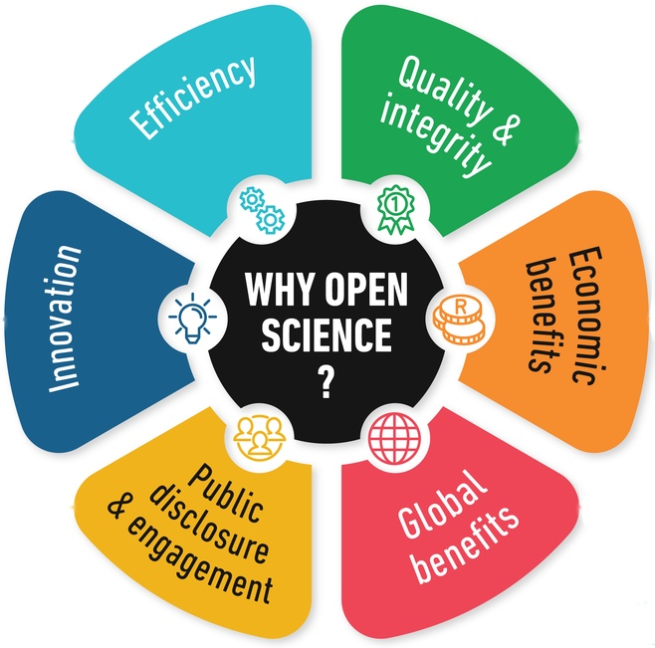
Benefits of Open Science
Increased citation rates
Better publication productivity
Higher impact of publications
Fewer errors in research
Networking opportunities
Innovation
Better documentation and reproducibility
Lower costs of performing research
Meeting funder requirements

Slide 8
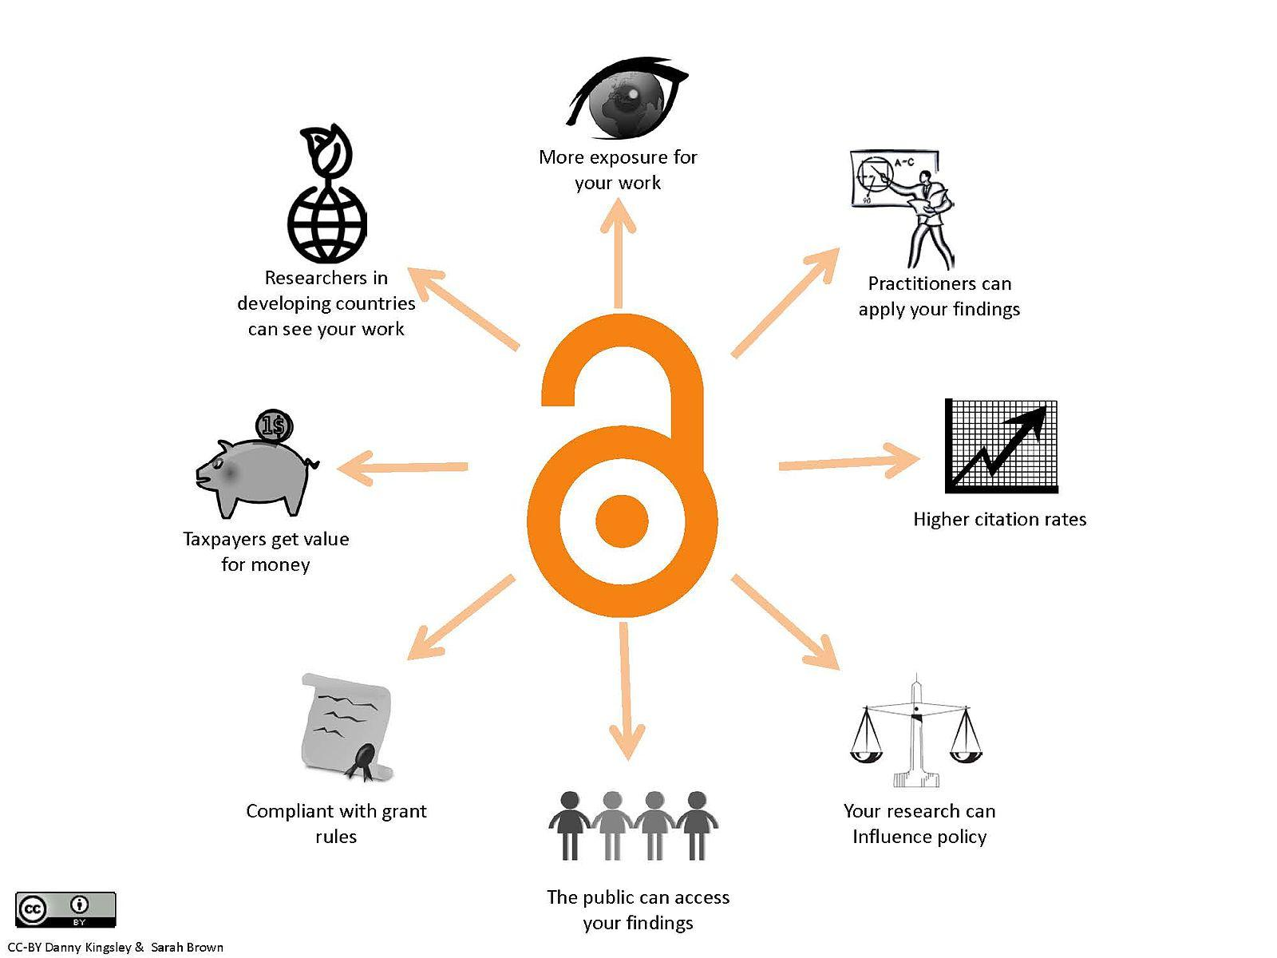
Open Access
One of the most well-established practices of Open Science.
Research publications can be accessed online, free of charge by any user and with no technical obstacles.
Other numerous academic, economic and societal advantages.

Slide 9
Join now!
Use and cite existing public data
Publish in open access journals
Share your research data through trusted repositories
Post preprints of research manuscripts online
If relevant, release the code and the environment needed to run in
Post free copies of your research articles online

Slide 10
References
FOSTER Open Science Training Handbook, https://book.fosteropenscience.eu
Kramer, B. & Bosman, J. (2018). Open Science and Scholarship, Changing your research workflow, Utrecht University Library, presentation slides, https://docs.google.com/presentation/d/1h_CpMY6iQ6xyOEW6DQmiB9GWCG16USIu_ClLPuMWGkY/edit#slide=id.g235946e421_2_79
Masuzzo, P. and Martens, L. (2018). Do You Speak Open Science? Resources and Tips to Learn the Language, PeerJ preprints, https://peerj.com/preprints/2689v1.pdf
McKiernan et al. (2016). Point of View: How open science helps researchers succeed, https://elifesciences.org/articles/16800v1
Spellman, B., Gilbert, E. A., & Corker, K. S. (2017). Open Science: What, Why, and How, https://doi.org/10.31234/osf.io/ak6jr
Tennant JP, Waldner F, Jacques DC et al. (2016). The academic, economic and societal impacts of Open Access: an evidence-based review. F1000Research 2016, 5:632, https://doi.org/10.12688/f1000research.8460.3
WhiteRoseBrussels, The European Open Science Cloud – the future of Open Access research, 29 March 2018, https://brussels.whiterose.ac.uk/the-european-open-science-cloud-the-future-of-open-access-research/

