Slide 1
What is European
Open Science Cloud?
João Mendes Moreira
Head of Scientific Information
Foundation for Science and Technology (FCT) | FCCN Unit, Portugal
Horizon 2020 Research and Innovation Programme
Grant Agreement # 857647

Slide 2
Snapshot
Introduction
What is European Open Science Cloud (EOSC)?
Tangible benefits
Challenges
Bigger picture
Learn more

Slide 3
Learning outcomes
Define the European Open Science Cloud (EOSC) programme.
Explain the key benefits and challenges of the EOSC.

Slide 4
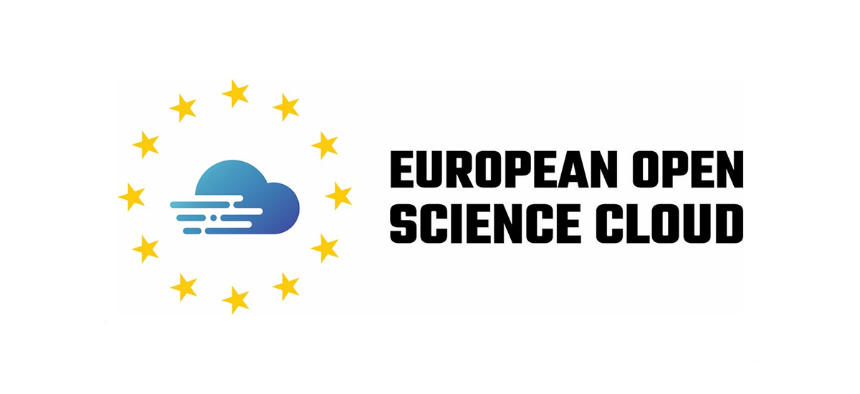
Introduction

Slide 5
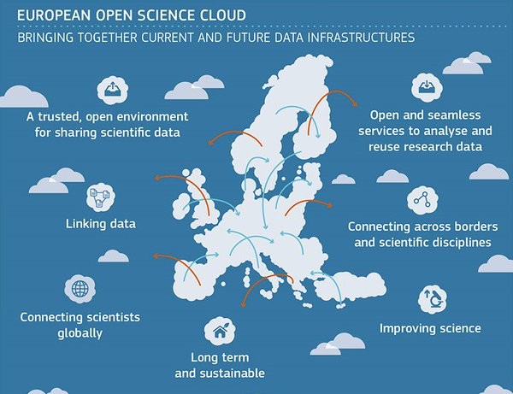
What is European Open Science Cloud (EOSC)?
Programme funded by the European Commission
40 countries involved
Reaches 1.7 million European researchers and 70 million students and professionals
Offers virtual environment with open and seamless services for research data
A range of projects running to help overcome existing challenges to EOSC

Slide 6
Tangible benefits
As a one-stop-shop, EOSC will enable researchers to manage data along the research life cycle and work with data in an integrated and simplified way.
Use and reuse of cross-disciplinary data will be more effective.
Researchers will be able to run simulations and perform experiments through a web interface.
EOSC supports the principles of Open Science, where researchers can build on existing data, and create new data.

Slide 7
Challenges
Key challenge is to convince service providers to align their services with EOSC.
Adjusting and adapting existing services means more investment and resources will be needed.
EOSC also means researchers will do research in different ways.
To make use of EOSC, researchers will need to train themselves and be encouraged to use the services as part of routine.

Slide 8
Bigger picture
Research data and related services will support building the European data economy.
EU member states are working hard to take this opportunity and be able to compete with other countries.
To be successful, EOSC needs to be straightforward and deliver value to the end user.
EOSC is to become a seamless and integrated set of infrastructures and services for better science; easy to use and free for all researchers and relevant stakeholders.

Slide 9
Summary
EOSC offers a virtual environment with open and seamless services for research data.
It will benefit researchers by:
Enabling them to manage data along the research life cycle and work with data in an integrated and simplified way.
Enabling them to run simulations and perform experiments through a web interface.
Enabling them to build on existing data, and create new data.
Making a more effective use and reuse of cross-disciplinary data.
The new European data economy is expected to increase national budgets and boost economies.

Slide 10
Learn more
European Commission, https://ec.europa.eu/research/openscience/index.cfm?pg=open-science-cloud
European Commission (2017), EOSC Declaration, https://ec.europa.eu/research/openscience/pdf/eosc_declaration.pdf#view=fit&pagemode=none
European Commission, Open Science Factsheet, https://ec.europa.eu/info/sites/info/files/research_and_innovation/knowledge_publications_tools_and_data/documents/ec_rtd_factsheet-open-science_2019.pdf
EOSC Portal, https://www.eosc-portal.eu
EOSC Secretariat, https://www.eoscsecretariat.eu
EOSC Synergy, https://www.eosc-synergy.eu

