Slide 1
EOSC in practice:
Facilitating software quality
across EOSC services
Pablo Orviz, Spanish National Research Council (CSIC) | Institute of Physics of Cantabria (IFCA)
Horizon 2020 Research and Innovation Programme
Grant Agreement # 857647

Slide 2
Learning outcomes
Explain the function of software quality assurance for EOSC services.
Define the benefits of the Software Quality Assurance as a Service platform (SQAaaS).

Slide 3
Snapshot
Introduction
End user as priority
Benefits
Challenges
Future
Learn more

Slide 4
Introduction
Today, there is a general agreement that software is a key pillar of Open Science.
EOSC Synergy facilitates software quality and helps ensure customer satisfaction with EOSC services.
The baseline criteria for the quality assurance of software and services will:
Foster good practices of developing a source code across Europe.
Enable to analyse and assess the quality of any EOSC service that is based on software.

Slide 5
End user as priority
Compliance with good practices in software development may represent a steep learning curve.
Setting up the infrastructure entails getting familiar with so-called continuous integration services (CIS).
EOSC Synergy is not limited to collecting and maintaining quality criteria for software and services.
The ultimate goal is to provide a platform that automates tasks as much as possible for the end user (Software Quality Assurance/SQA as a Service).

Slide 6
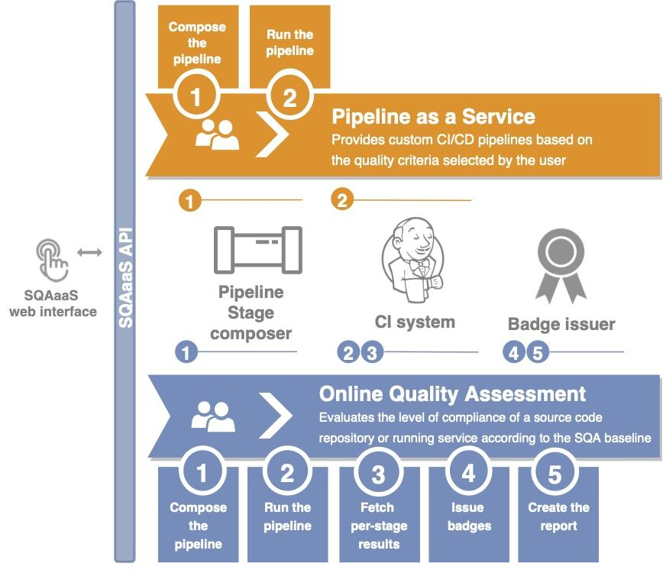
Benefits
By using a web interface, the end user can select the criteria that they want to use in their software code.
SQA-as-a-Service will allow the end user to customise their own baselines with the criteria they want to apply to their code, and thus, suitable for any use case.
End user will receive a report and a digital badge indicating the quality of the source code.
The badge recognises hard work and provides confidence and trust for the end user.
High-level overview of the SQAaaS
Notes:
The figure is a high level overview of the SQAaaS (Software Quality Assurance as a Service) component that will be developed throughout the Synergy project. You can see 2 outputs we will deliver: the pipeline-as-a-service (that will compose customized pipelines based on the end user selection) and the quality assessment itself, which will provide a quality report and the associated quality (digital) badge, so that users of the software/service can know at a glance its quality attributes/achievements.

Slide 7
Challenges and future
The biggest challenge is cultural.
Still, researchers need to embrace the values of Open Science.
Others will only adopt software and services if these meet the quality criteria.
The baseline criteria are available in a GitHub repository.
SQA-as-a-Service platform is expected to be ready in early 2022.

Slide 8
Summary
EOSC Synergy facilitates software quality and helps ensure customer satisfaction with EOSC services.
Software Quality Assurance as a Service (SQAaaS) will foster good practices of developing a source code and enable to analyse and assess the quality of any EOSC service that is based on software.
Still, many researchers need to understand that their software and services should meet quality criteria to win users’ trust.

Slide 9
Further information
Orviz, P. et al (2020) A set of Common Software Quality Assurance Baseline Criteria for Research Projects, https://github.com/indigo-dc/sqa-baseline(software) & https://indigo-dc.github.io/sqa-baseline/(web)
Orviz, P. et al (2020) A set of Common Service Quality Assurance Baseline Criteria for Research Projects, https://github.com/EOSC-synergy/service-qa-baseline (service) & https://eosc-synergy.github.io/service-qa-baseline/ (web)

